Slide 1


Calculating Nash Equilibrium on Quantum Annealers
Olga Okrut on behalf of
Dark Star Quantum Lab, Inc. Apex, NC, USA
Notes:
Hello everyone! First of all, let me say Thank you to the QWorld Quantum Science Days for an opportunity to present today. I am Olga Okrut, a Quantum Computation Researcher at Dark Star Quantum Lab.

Slide 2






Dark Star Quantum Lab Inc. matches industrial problems with the right quantum technology solutions, offering customers "Quantum of Advantage", a meaningful business advantage in the form of revenue and project management governance by way of cost reduction, bottleneck mitigation, and simplification.
We offer expertise in formatting industry problems for execution on quantum computers 1.0 and advice on best practices in adopting and integrating quantum computing technology into enterprise. As early adopters of quantum computing technology, our clients benefit from incremental advantage while becoming ready to reap the benefits of “Quantum Advantage” when it manifests 5-10 years from now.
Nada Elsokkary
Quantum Solutions Architect
Kareem H. El-Safty
Quantum AI Engineer
Faisal Shah Khan, PhD
Founder and Interim CEO
Olga Okrut
Quantum Computation Scientist
Keith Cannon
Quantum Solutions Architect
David D’Silva, BMath
Founder and Chief Operating Officer
https://www.darkstarquantumlab.com/
Notes:
Today I would like to present on behalf of the Team Of Dark Star Quantum lab. We are the team of creative professionals tackling problems that are challenging to solve on conventional computers. Many professionals in the area of Quantum computing are sceptical about current stage of quantum hardware and its usefulness, yet we want to show Quantum of Advantage, meaning Delivering marginal but meaningful improvements in the near term.

Slide 3
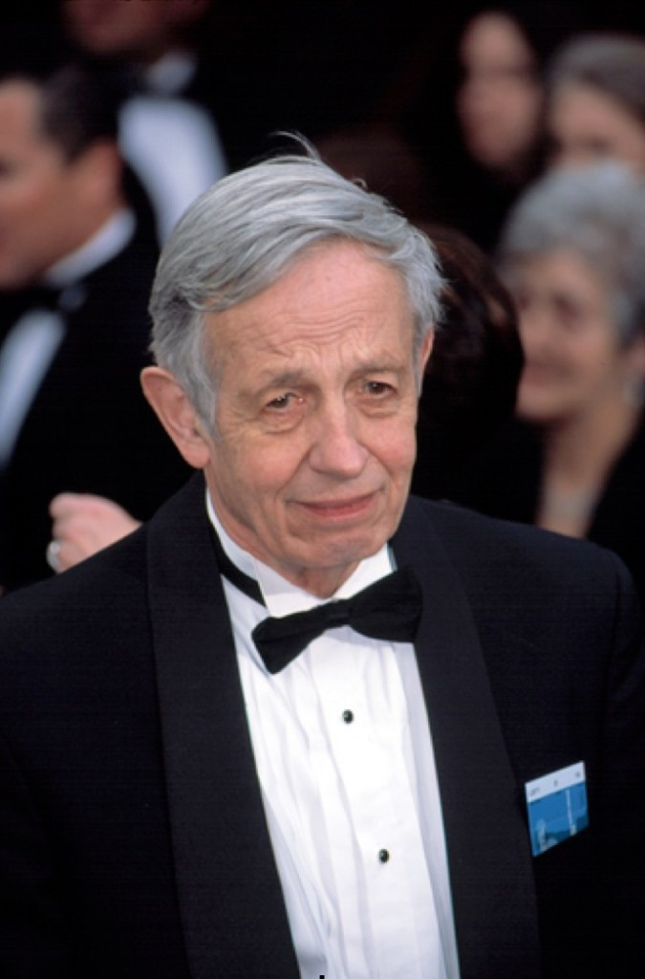
John Forbes Nash (June 13, 1928 - May 23, 2015)
The concept of the Nash Equilibrium (NE) is named after an American mathematician - John Nash who is famous for his fundamental contributions to the game theory.
J. Nash is the winner of the Nobel Memorial Prize in Economic Sciences (1994).
The concept of the NE is widely applied in economics, stock market, evolutionary biology, politics, law, and other human/agent interactions.
Notes:
Today, I would like to talk about the concepts of NE and solutions on Simulated Quantum Annealing as well as the physical D-Wave's Quantum Annealers. Let me start with brief introduction to the NE. The concept of NE is named after its inventor, the Nobel Memorial Prize winner in Economic Sciences, John Nash. Although the concept is part of game theory, it finds its wide application in a variety of studies such as economics, stock market, politics, or even in the evolutionary biology.

Slide 4
Nash Equilibrium: Definition
NE is the solution concept for non-cooperative games such that no player is motivated to unilaterally deviate from their particular choice of strategy.
$$Π_{1}\left(p^{∗},q^{∗}\right)≥Π_{1}\left(p,q^{∗}\right)$$
$Π_{1}$, $Π_{2}$ are payoff functions for the strategies (p, q).
Set of strategies or actions in which each firm does the best it can given its competitors’ actions.
“A pair of strategies is a Nash equilibrium in a game if and only if each strategy is a best reply to each other” [K. Binmore, 2007].
Notes:
The concept of NE is a concept within game theory saying that the optimal outcome of a game is the outcome where no player has an incentive (инсентив) to deviate from their chosen strategy. So, NE can be thought of as a decision-making theorem which attempts to determine (детермен) mathematically and logically the actions that participants of a game should take to secure the best outcomes for themselves. In this case, If a strategy of a player is in a Nash Equilibrium and this player decides to deviate from their chosen strategy, they receive a poorer outcome. The outcome here can be satisfaction or money. Depending on a game, there can exist many Nash Equilibria or no NE exist.

Slide 5
Nash Equilibrium: Examples
Politics : Mutually Assured Destruction (MAD) of the Cold War era.
Economics and finance : Strategic pricing, trade, and bargaining.
Biology and behavioral science: persistence of behaviors (strategies) against changing times. (A Bird Game in “Calculating Nash Equilibrium on Quantum Annealers”)
Notes:
For example, NE describes political decisions during the Cold War, or recent India-Pakistan MAD in nuclear weapons, decisions in the market, or even ONE can describe processes in evolutionary biology, an example of which you could find in our paper.

Slide 6
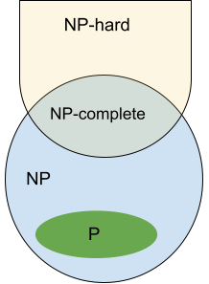
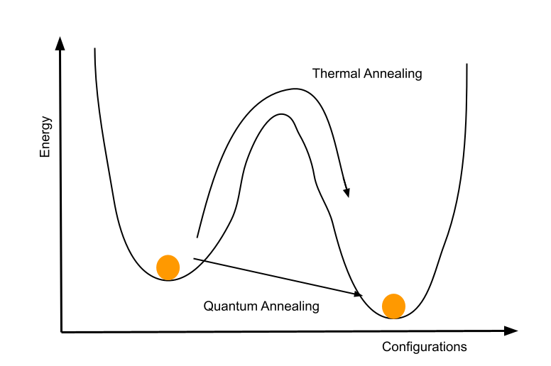
Nash Equilibrium: Motivation
Solving NE in pure strategies is NP-complete.
Existing Algorithms:
Enumeration/Iteration (fail on large numbers)
Stochastic Approach (gives approximation of NE points).
Brute-Force Algorithms (not efficient, work for small games)
A good candidate to be executed on a Quantum Annealer device which utilizes quantum tunneling effect and can reach the global minimum faster.
Goals:
Formulate as QUBO (Quadratic Unconstrained Binary Optimization)
Execute as Simulated Annealing
Execute on a QPU device
Notes:
Although the problem of finding NE for two players seems to be easy enough to solve on conventional computers, nevertheless, as the number of players and strategies increase, the problem becomes NP-complete in pure strategies. So, it is impossible to find NE using simple algorithms such as the iterations (итерашнс), stochastic algorithms, or brute-force algorithms that are mainly used to approach the problem. These algorithms are good for small games but for larger games they fail to find all NE points or they provide an approximation of NE points. Saying this, finding NE points requires a revision of existing approaches and a development of new algorithms. In our work, we aim to find NE points using Quantum inspired algorithms, that is simulated Annealing and a physical Quantum hardware. In particularly, The real Quantum hardware utilizes the phenomena of the quantum tunneling (танелин) to reach a global minimum faster in comparison to the SA. So, our goals for this research were to formulate a problem of finding NE points as a QUBO (Quadratic Unconstraned Binary Optimization), secondly, we would like to test our formulation as a simulated annealing, and finally solve NE problem on D-Wave’s Quantum Annealer.

Slide 7




Formatting NE for Quantum Annealer: Ising and QUBO
$$ℋ_{Ising}=\sum_{i∈V}{h_{i}s_{i}}+\sum_{i,j∈E}{J_{ij}s_{i}s_{j}}$$
Ising Hamiltonian Form:
$$s=2x −1$$
QUBO (Quadratic Unconstrained Binary Optimization) Form:
$$QUBO=\sum_{i}{a_{i}x_{i}}+\sum_{j>i}{b_{ij}x_{i}x_{j}}$$
$a_{i}$, $b_{ij} ∈ℝ$ and $x_{i}∈ \left\{0,1\right\}$
Notes:
[Slide 7]: First, we have mathematically formatted the problem such that it matches Ising Hamiltonial Formulation that is the underlying concept of D-Wave’s Quantum Annealers. In other words, we stated the problem as Quadratic Unconstrained Binary Optimization Problem. That can be easily done by switching from the spin-variables s sub i’s to the binary variables x sub i’s. This reformulation allows us to search for NE points in pure strategies immediately, with no extra post-processing later.

Slide 8





Formatting NE for Quantum Annealer: Payoff Matrices
Player 1: Payoff Matrix $M_{nm}$, strategies $p_{i}$
Player 2: Payoff Matrix $N_{mn}$, strategies $q_{i}$
Where (i, j) entry of either matrix equaling the payoff to the player when first employs their $i^{th}$ strategy and the second employs $j^{th}$ sytategy.
Payoffs:
$Π_{1}(p,q)=p^{T}Mq$ and $Π_{2}(p,q)=p^{T}Nq$
Where $p=\left(p_{1}, …p_{n}\right) and q=(q_{1}, …q_{n})$ are probability distributions. In general, $p$ and $q$ represent mixed strategies.
Find strategies $p_{i}$ and $q_{i}$ that maximize the total payoff:
Maximize: $p^{T}\left(M+N\right)q−α−β$
Where $α$ and $β$ scalars whose maximum values equals to the expected payoffs to both players.
Notes:
[Slide 8]: In general, one is required to know the payoff matrices for each of players in the game. Let’s call them the M and N matrices, the payoff of the first player is given by the matrix form p transposed times M times q, and the payoff of the second player is p transposed times N times q. Where p and q are strategies for each player. In general, we format as QUBO for mixed strategy games meaning that the strategies can be rational variables. But We will solve for pure strategy, because of the current quantum hardware limitations. In other words, we can solve only with zeroes and ones. One is interested in gaining a maximum payoff from the game played, hence we want to maximize the total payoff for both players.

Slide 9




Formatting NE for Quantum Annealer: Constraints
Adding constraints as penalty terms.
Enforce that all players play one strategy :
$$\sum_{i}{p_{i}=1}$$
$$\sum_{j}{q_{j}=1}$$
and
A necessary and sufficient condition for NE point(s) to exist according to Kuhn-Tucker constrained optimization theorem [O.L. Mangasarian et al., 1964.].
$$\sum_{i,j}{n_{j,i}p_{i}−}β≤0$$
$$\sum_{i,j}{m_{i,j}q_{j}−}α≤0$$
and
Notes:
[Slide 9]:Of course, the formulation of a NE problem is not full with missing constraints that we can add as the penalty terms to the QUBO. The first constraints are relatively simple, they say that each player must play one strategy only. That is, a player can not consider two different actions simultaneously. The second constraint arises under Kuhn-Tucker (кун- такер) constrained optimization Theorem that ensures the existence of NE points in a game.

Slide 10

Formatting NE for Quantum Annealer: QUBO
Minimize:
$F=−p^{T}\left(M+N\right)q+α+β−θ_{1}{\left(\sum_{i}{p_{i}−1} \right)}^{2}−θ_{2}{\left(\sum_{i}{q_{i}−1} \right)}^{2}−λ_{i}{\left(\sum_{i,j}{n_{j,i}p_{i}−}β+η\right)}^{2}−φ_{i}{(\sum_{i,j}{m_{i,j}q_{j}−}α+ξ)}^{2}$
Where $θ_{1}$, $θ_{2}$, $λ_{i}$, $φ_{i}$ are penalty term multipliers, and $η$ and $ξ$ are non-negative slack variables to transform inequality constraints to corresponding equality constraints.
Notes:
[Slide 10]:Gathering everything together and adding constraints as the penalty terms, we obtain the general expression for the QUBO. Where, the terms in the purple box correspond to a solution of an unconstrained counterpart, and the parts in the green and pink boxes are the constraints multiplied by corresponding penalty term multipliers. Since one can not solve a problem as finding a global maximum on Quantum Annealers, one can play a simple mathematical trick of minimizing the same objective function but with the opposite sign. That is why, the problem becomes a minimization problem and all the signs in the expression are reversed.

Slide 11
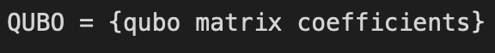
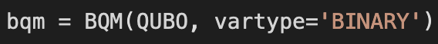
Simulated Annealing. Quantum Processing Unit (QPU)
Execution via D-Wave’s API package – dimod:
1) Construct a QUBO matrix
2) Construct Binary Quadratic Model (BQM)
3) Add Constraints as penalty terms
Notes:
[Slide 11]: As soon as one has formulated a problem of finding NE in a QUBO format, the next step would be to submit a problem to a Quantum Annealer or to a QPU. For both approaches, the beginning is similar, you have to submit the coefficients of the QUBO matrix for a game. The second step is to define a model. In our research we used BQM from the beginning but depending on the preferences and needs, one can also use Constraiend Quandratic Model or CQM. Thirdly, one has to add all corresponding constrained and penalty multipliers to the binary model. Again, one could use different approaches here depending on the previous step please refer to the DWave’s tutorials and documentations.

Slide 12
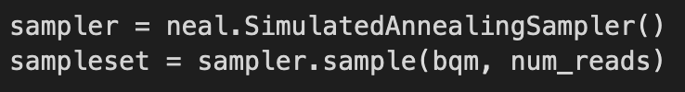
Simulated Annealing. Quantum Processing Unit (QPU)
D-Wave’s QPUs – 2000 Q6 and Advantage 4.1 – available via AWS Braket
Simulated Annealing
4) Submit to Simulated Annealing Sampler
4) Embedding:
a) select from the available via D-Wave’s SDK
(EmbeddingComposite, FixedEmbeddingComposite)
b) implement a custom embedding
(out of score for this research)
5) Analyze Results & Debug
5) Data Postprocessing
6) Analyze Results & Debug
Notes:
[Slide 12]: The part with the Simulated Annealing is relatively easy. We submitted to the Similated Annealing Sampler available through D-Wave’s Software Package and got our first results. Nevertheless, the things are different for the real D-Wave Quantum annealers. Prior to submitting to the QPU, we have to undergo an embedding into the D-Wave’s topological graph. In general, one can use available algorithms of embeddings in the D-Wave's SDK such as Embedding Composite (кампАзит) or Fixed Embedding Composite or implement a custom embedding. After running an experiment on the QPU, it is also nice to consider a classical data post processing that can narrow down solutions and improve the quality of results.

Slide 13
NE Example: The Battle of the Sexes
Problem formulation: A couple, Adam and Beth, decide independently whether to go to a soccer game or to the ballet in the evening. Each person likes to do something together with the other, but the man prefers soccer, and the woman prefers ballet.
Assume that the total payoff for each player is the sum of the payoffs in terms of satisfaction of being at the preferred place with the partner. For instance, for Adam choosing "soccer" (+2 points to satisfaction), Beth's best response would be "soccer" as well (+1 point to satisfaction). For Beth choosing "ballet" (+2 points), Adam's best response is "ballet" (+1 point). If both decide to visit different places, both of them would be dissatisfied.
 | Beth, Soccer | Beth, Ballet
Adam, Soccer | (+2, +1) | (-1, -1)
Adam, Ballet | (-1, -1) | (+1, +2)
Notes:
[Slide 13]: So, let’s consider one of the examples you can find in our paper, that is the Battle of the Sexes. For the score of this presentation I am considering the simplest example of two players two strategies game but you can find more sophisticated examples down the paper. Consider a couple that likes to do something together but one of them, Adam, prefers to watch a soccer game, and the other player, Beth, likes ballet. You can see a payoff matrix for both players, and their payoffs depend on their choice of strategy and the strategy of their partner. Payoff in this example represents satisfaction, e.g. how happy will be both of them. For example, if Adam goes to soccer and Beth goes to the Ballet, both of them are unsatisfied with their choice of actions because they do something separate. However, if, for example, both of them go to a soccer game, then Adam is satisfied, he gains +2 to his satisfaction, Beth is a little bit not that happy, but anyway she gains +1 to her satisfaction. If you analyze the table, you can find that if both players go to the soccer game or to the ballet, then they receive the maximum total payoff. That is, there are 2 NE points in pure strategies in this problem.

Slide 14






NE Example: The Battle of the Sexes
Strategy
Payoff Matrix
Adam
$p=\left[\begin{aligned}p_{1} \\ p_{2}\end{aligned}\right]$
$$M=\left[\begin{matrix}2 & −1 \\ −1 & 1\end{matrix}\right]$$
$F=−p^{T}\left(M+N\right)q+α+β−θ_{1}{\left(\sum_{i}{p_{i}−1} \right)}^{2}−θ_{2}{\left(\sum_{i}{q_{i}−1} \right)}^{2}−λ_{i}{\left(\sum_{i,j}{n_{j,i}p_{i}−}β+η\right)}^{2}−φ_{i}{(\sum_{i,j}{m_{i,j}q_{j}−}α+ξ)}^{2}$
Beth
$$q=\left[\begin{aligned}q_{1} \\ q_{2}\end{aligned}\right]$$
$$N=\left[\begin{matrix}1 & −1 \\ −1 & 2\end{matrix}\right]$$
Minimize:
$$−3p_{1}q_{1}+2p_{1}q_{2}+2p_{2}q_{1}−3p_{2}q_{2}+α+β−θ_{1}{\left(p_{1}+p_{2}−1\right)}^{2}−θ_{2}{\left(q_{1}+q_{2}−1\right)}^{2}−λ_{i}{\left(p_{1}−p_{2}−β+η\right)}^{2}−λ_{i}{\left(−p_{1}+2p_{2}−β+η\right)}^{2}−φ_{i}{\left(−q_{1}+q_{2}−α+ξ\right)}^{2}−φ_{i}{(2q_{1}−q_{2}−α+ξ)}^{2}$$
Notes:
[Slide 14]: for the given problem we need binary variables that represent strategies for both players, and the payoff matrices for both players. Taking into account the objective function together with the penalties that I have defined during the theoretic overview part, we can construct the objective function for the Battle of the Sexes example. Again, we want to maximize the total payoff but since a Quantum Annealer can minimize only, we consider the objective function for this game with an opposite sign.

Slide 15
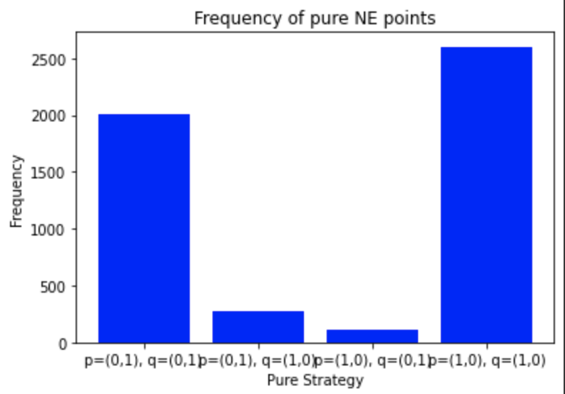
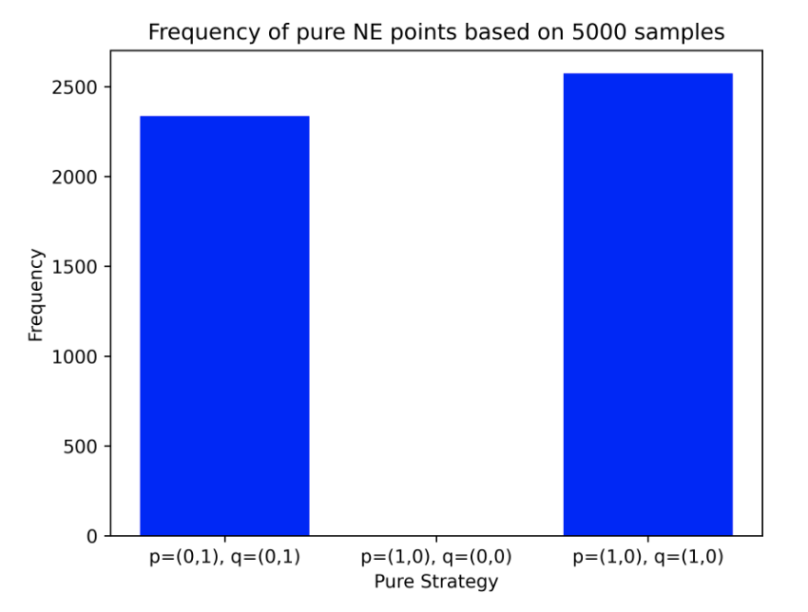
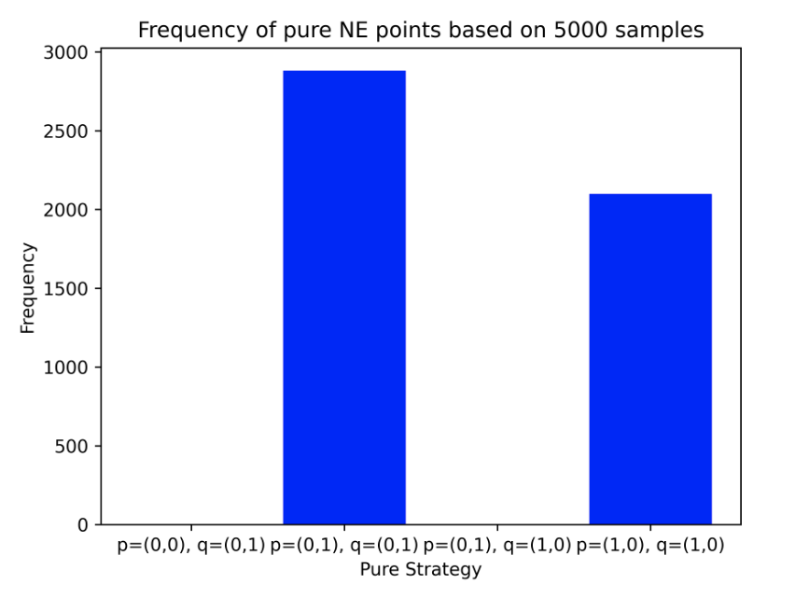
The Battle of the Sexes: Results
Simulated Annealing
D-Wave Advantage 4.1 QPU
D-Wave 2000 Q6 QPU
Results: 1) Adam and Beth play (0, 1), e.g. both go to the ballet
OR
2) Both play (1,0), e.g. both go to a soccer game
Notes:
[Slide 15]: so, what are the results after execution as a simulated annealing algorithm and the execution on the D-Wave’s Advantage and D-Wave’s 2000 Q6 QPUs? Where the access to the D-Wave's QPU were done though the cloud services provided by AWS Braket. You can observe that the results from all three executions are aligned with our analytical approach that we discussed on the previous slides. You can observe two picks in here that correspond to the strategy choices when both players go either to a soccer game or to the ballet. In terms of variables, the binary vectors of strategy (0,1) and (1, 0) correspond to these decisions. In the case of Simulated annealing you can also observe some minor picks at other than NE points which may represent a fact that the algorithm is stuck at local minima sometimes during the execution.

Slide 16
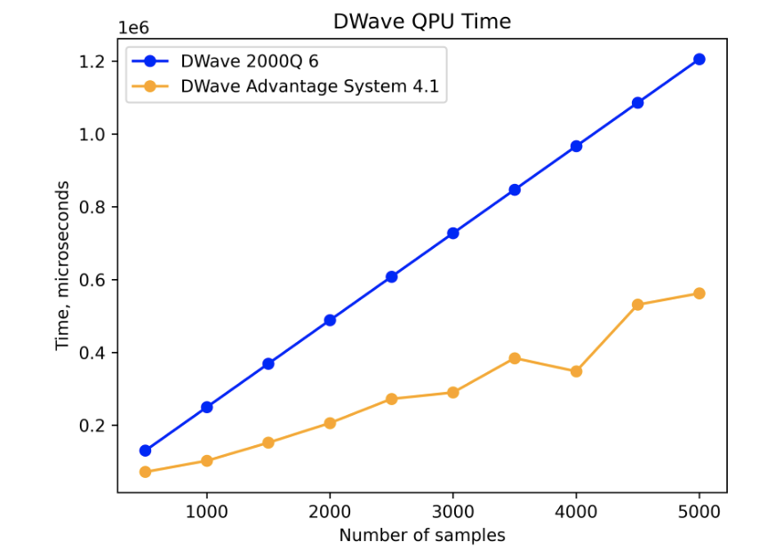
Nash Equilibrium: Quantum Advantage
Performance Game | Simulated Annealing Intel Core i-5, 1.6 GHz CPU Time | D-Wave Advantage 4.1 QPU Time
2 strategies The Battle of the Sexes | 0.6 sec | 0.5 sec
3 strategies A Bird Game: Evolutionary Biology | 3.2 sec | 0.5 sec
8 strategies Evolutionary Stable Strategy | 15.4 sec | 0.7 sec
(!) Internet Latency: delay in sending/receiving results from AWS Braket of 12-13 seconds.
Notes:
[Slide 16]: the other question that we were interested to confirm or not to confirm is some kind of speed up in finding NE points for larger problems. In the table you can observe a short summary on the algorithm execution as Simulated annealing on a conventional computer with the Intel Core i-5 CPU and the latest graph topology QPU from D-Wave, Advantage 4.1. The graph depicts the total qpu access time that can be obtained as the return parameters from running an algorithm (QPU Access time= preprogramming, annealer time, extra low-level operations associated with the execution of QPU). As you can see the trends, the time of the execution on classical machines increases with the increasing number of strategies. That is, the execution time was around 0.6 seconds for 2 strategies games, however, increased to 15.4 seconds for 8 strategies games. However, the QPU time for all numbers of strategies remains under a second. We anticipate to see the same QPU time for the games that require up to 100 logical variables. To our disappointment, we have to admit that we observed a delay time from the AWS Braket of around 12-13 seconds in sending and receiving data from the D-Wave Annealers.

Slide 17
Nash Equilibrium: Conclusions
Format the problem of finding NE points in two players competitive games as QUBO for an execution on Quantum Annealer. Constraints can be submitted as penalty terms.
Speed-up in finding NE points on QPU is 6-22 times in comparison to the CPU (Central Processing Unit).
The results of computation on the QPU depend on the additional formatting such as D-Wave graph embedding, choice of penalty multipliers.
Additional results post-processing may be required.
Notes:
[Slide 17]: To conclude, 1) in this research we were able to format the problem of finding NE points in the QUBO format to execute as a simulated annealing and on the real Quantum hardware represented by D-Wave’s Quantum Annealer. 2)We observed a speed-up of the QPU time over the CPU time of 6-22 times depending on the number of strategies. 3)For the problems that are required to be submitted to a physical QPU, one has to undergo the process of additional data preparation such as embedding and the choice of penalty multipliers. These preparations could significantly influence outcomes such as the number of NE Points or quality of solutions. 4)For the games with a larger number of strategies, classical post processing may be required to narrow down the best solution of a problem.

Slide 18
NE: Further Research
Finding NE points in mix strategy games (currently, quantum devices support binary variables)
Finding NE points using hybrid quantum-classical algorithms (AWS Braket does not support D-Wave Leap Hybrid Solver)
Performance comparison of classical algorithms (enumeration, stochastic algorithms, etc.) and quantum inspired.
Finding NE points for a larger number of strategies (roughly up to 150 strategies).
Finding a better embedding to D-Wave’s graph topology.
Notes:
[Slide 18]: Of course, we should admit that it was the first research done in finding NE points in pure strategies and certainly has some areas of further improvement. For instance, 1) it would be nice to silvo NE for the mixed strategies game which is impossible right now due to the current limitations in the quantum hardware. 2) The Classical-quantum, or Hybrid, approach could enhance the outcomes in terms of performance and quality of solutions for problems with 50 or more strategies (Benchmarking D-Wave’s Quantum Annealers with exact cover problems). 3) Comparison tests between SA and QPU and classical algorithms. 4)Solving for the games with 150 strategies, and 5) finding a custom embedding that allow to increase a success rate in finding NE points.

Slide 19
References
K. Binmore, Player for Real, Publisher: Oxford University Press; Illustrated edition, March 29, 2007.
O.L. Mangasarian et al., Two person non-zero sum games and quadratic programming, Journal of Mathematical Analysis and Applications, Volume 9, pages 348-355, 1964.
F. Glover et al., Quantum Bridge Analytics I: a tutorial on formulating and using QUBO models, pre-print available at https://arxiv.org/ftp/arxiv/papers/1811/1811.11538.pdf.
D-Wave, The Quantum Computing Company, Getting Started with D-Wave Solvers, User Manual, 2021-10-20. https://docs.dwavesys.com/docs/latest/ downloads/ced4bf7d70d137767f74f8bf99173832/09-1076D-C_GettingStarted.pdf
D-Wave, The Quantum Computing Company, D-Wave QPU Architecture: Topologies https://docs.dwavesys.com/docs/latest/c gs 4.html?highlight=advantage%20system#pegasus-graph
Willsch, D., Willsch, M., Gonzalez Calaza, C.D. et al. Benchmarking Advantage and D-Wave 2000Q quantum annealers with exact cover problems, Quantum Inf Process 21, 141 (2022).
N. Elsokkary et al., Financial Portfolio Management using Adiabatic Quantum Optimization: The Case of Abu Dhabi Securities Exchange, Proceedings of IEEE High Performance Extreme Computing conference, 2017.
J. Nash, Equilibrium points in n-person games, Proceedings of the National Academy of Sciences, Volume 36, Number 1, 1950.

Slide 20
Contact:
faisal@darkstarquantumlab.com
Visit:
https://www.darkstarquantumlab.com/
GitHub:
https://github.com/DarkStarQuantumLab
Thank You!
Notes:
[Slide 19]: Last but not least, Thank you for your attention and questions and comments are welcome!

